Slide 1

Unit – 1 Introduction to Engineering Graphics
Engineering Graphics and Design (EG&D)
GTU #3110013
Mr. Ankur N. Tank
Department of Mechanical Engineering
ankur.tank@darshan.ac.in
9712804466

Slide 2


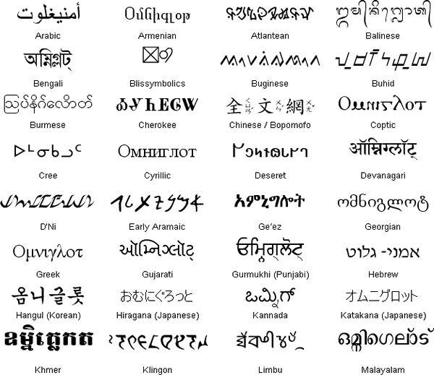

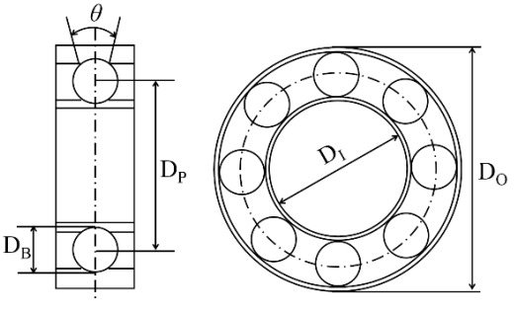


Modes of Communication
Language
Sign
Language
Graphical Language
Written Language
Vocal/Spoken Language
Computer Language
Engineering Drawing
Modern
Art/Painting

Slide 3

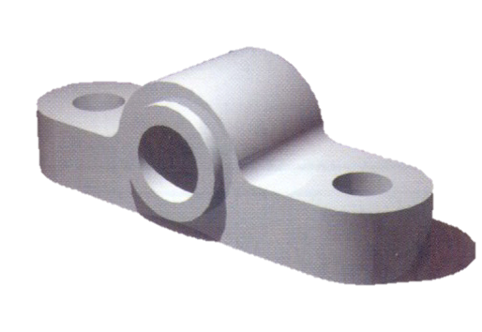


Importance of Engineering Graphics Language or Drawing
Try to write a description of this object.
Test your written description by having someone attempt to make a sketch from your description.
Outcome of this exercise : The word languages are insufficient for describing the size, shape and features completely as well as in details.

Slide 4
Structure of Graphics Language
Graphics language in “Engineering Application” uses lines to represent the following
Surfaces
Edges
Contours
The language is known as “Drawing” or “Drafting”.
A drawing can be done using “Freehand, Instruments or Computer applications’.
Contours
Surfaces
Edges

Slide 5
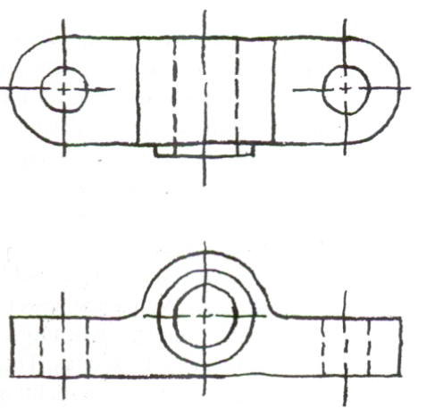
Free Hand Drawing
The lines are sketched without using instruments other than pencils and erasers.

Slide 6
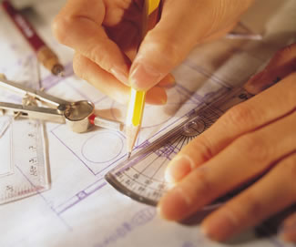
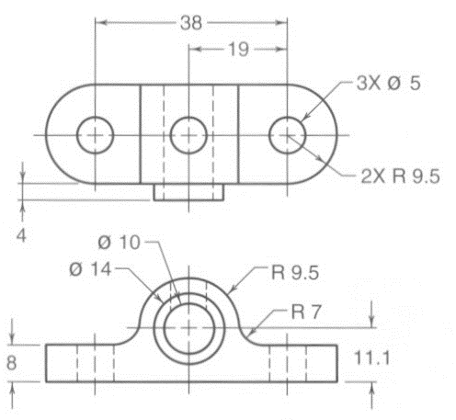
Instrument Drawing
Instruments are used to draw straight lines, circles, and curves concisely and accurately. Thus, the drawings are usually made to scale.

Slide 7


Drawing by using Computer Applications
The drawings are usually made by commercial software such as AutoCAD, Creo, Solid Works etc.

Slide 8
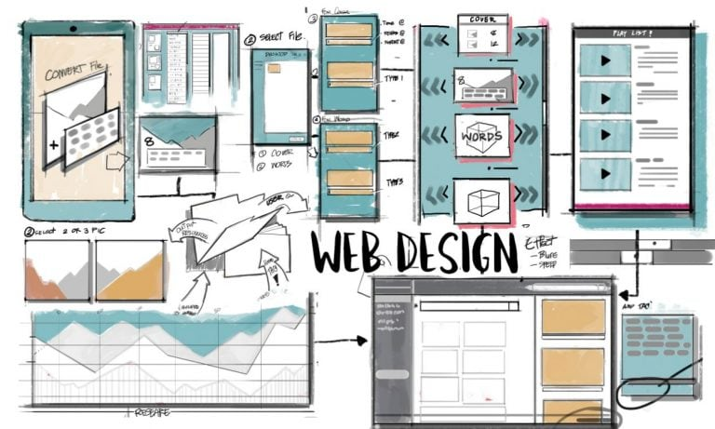


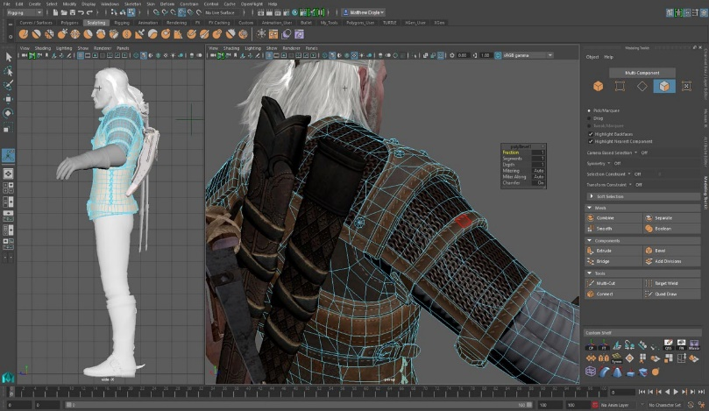

Application of EG&D in CSE
Computer Engineering
Graphics Design and 3D Modeling Software Coding
2D and 3D Gaming Design
Website and Application Design
OS Icon Design

Slide 9
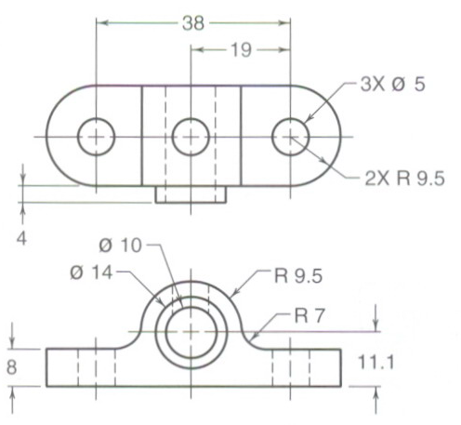
Graphics or Drawing Language
Engineering drawings are made up of graphics language and word language.
Graphics Language: Describes shapes mainly
Word Language: Describes size, location and specification of object

Slide 10
Elements of Graphics or Drawing Language
Line Types
Letters
Graphics Language
Projection Methods
Word Language
Numbers
Geometric Constructions
Notes

Slide 11
Drawing Standards
Drawing Standards are set of rules that govern how technical drawings are represented.
Drawing standards are used so that drawings convey the same meaning to everyone who read them.
BIS-SP 46 Standards:
The BIS-SP 46 – 1988 is the standard which is for "Engineering Drawing Practice for Schools & Colleges” and revised as SP – 46 in 2003.
Following standards are commonly used in drawing practice:
IS 1444:1989 - DRAWING BOARD SPECIFICATIONS
IS 15021:2001 - PROJECTIONS METHOD
IS 3221:1966 - DRAWING INSTRUMENTS
IS 10713:1983 - SCALES
IS 10714:2001 - LINES
IS 9609:2001 - LETTERING
IS 11669:1986 - DIMENSIONING
IS 10711:2001 - SIZE & LAYOUTS OF DRAWING SHEETS

Slide 12
Standard Codes - Country wise
Country
Code
Full Name
USA
ANSI
American National Standard Institute
Japan
JIS
Japanese Industrial Standard
UK
BS
British Standard
Australia
AS
Australian Standard
Germany
DIN
Deutsches Institut für Normung
India
BIS
Bureau of Indian Standards
ISO
International Standards Organization

Slide 13
Drawing Instruments

Looping
What we learned
Modes of Communications
Graphics language, structure and its importance in Engineering Field
Introduction to BIS SP- 46 Standards
Thank you…!
“Drawing is not what one sees but what one can make others see.” – EDGAR DEGAS
Next Topic

